Slide 1
Doubly Linked List (DLL)
In a singly linked list (SLL) one can move beginning from the head node to any node in one direction only (from left to right)
SLL is also termed as one –way list
On the other hand, Doubly Linked List (DLL) is a two-way list
  One can move in either direction from left to right and from right to left
This is accomplished by maintaining two linked fields instead of one as in a SLL

Slide 2
Motivation
Doubly linked lists are useful for playing video and sound files with “rewind” and “instant replay”
They are also useful for other linked data which require “rewind” and “fast forward” of the data

Slide 3
Doubly Linked List
Each node on a list has two pointers.
A pointer to the next element.
A pointer to the previous element
The beginning and ending nodes' previous and next links, respectively, point to some kind of terminator, typically a sentinel node or null, to facilitate traversal of the list
…
…
…
…

Slide 4
Doubly-Linked Lists (DLL)
Here is a doubly-linked list (DLL):
Head
56
67
93
Each node contains a value, a link to its successor (if any), and a link to its predecessor (if any)
The header points to the first node in the list and to the last node in the list (or contains null links if the list is empty)

Slide 5
Doubly Linked Lists
In a Doubly Linked List each item points to both its predecessor and successor
  prev points to the predecessor
  next points to the successor
10
20
40
55
70
Head
Cur->prev
Cur
Cur->next

Slide 6
DLLs compared to SLLs
Advantages:
  Can be traversed in either direction (may be essential for some programs)
  Some operations, such as deletion and inserting before a node, become easier
Disadvantages:
  Requires more space to store backward pointer
  List manipulations are slower
    because more links must be changed
  Greater chance of having bugs
    because more links must be manipulated

Slide 7
Double Linked List – Definition in C
struct Node{
int data;
Node* next;
Node* prev;
};

Slide 8
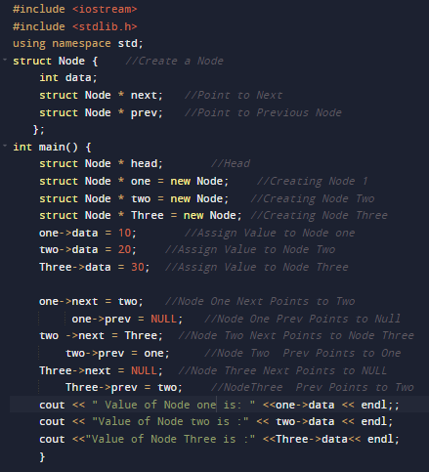
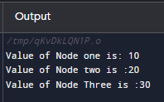
Double Linked List – Creation in C ++

Slide 9
Doubly Linked List Operations
insertNode(Node *Head, int item)
//add new node to ordered doubly linked list
deleteNode(Node *Head, int item)
//remove a node from doubly linked list
searchNode(Node *Head, int item)
print(Node *Head, int item)

Slide 10
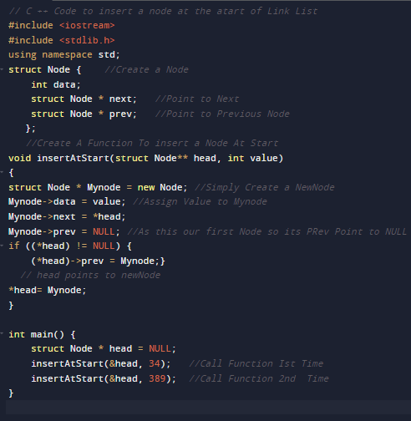

Insert a Node At Start

Slide 11
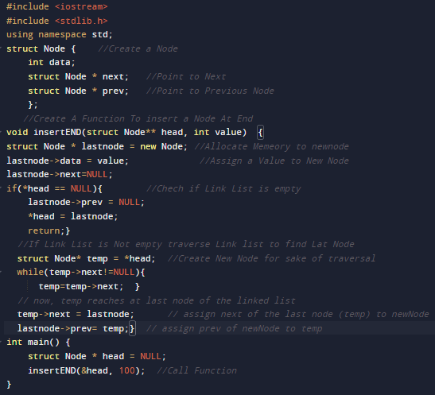
Insert a Node At End

Slide 12
Doubly – Linked List
DELETE:
Pointer change for implementation of a Deletion

Slide 13
Deleting a node from a DLL
Node deletion from a DLL involves changing two links
In this example, we will delete node 67
Head
56
67
93
We don’t have to do anything about the links in node 67
Deletion of the first node or the last node is a special case

Slide 14
Deleting a Node
Delete a node Cur (not at front or rear)
(Cur->prev)->next = Cur->next;
(Cur->next)->prev = Cur->prev;
delete Cur;
10
20
40
55
70
Head
Cur

Slide 15
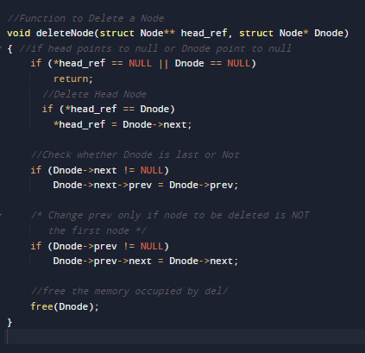
Delete Node in DDL

Slide 16
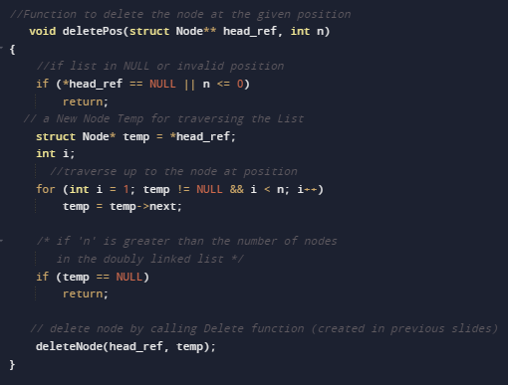
Delete Node At Given Position in DDL

Slide 17
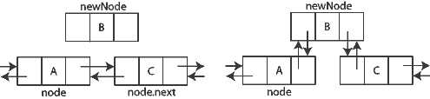
DLL - Insertion

Slide 18
Inserting a Node
Insert a node NewNode before Cur (not at front or rear)
NewNode->next = Cur;
NewNode->prev = Cur->prev;
Cur->prev = NewNode;
(NewNode->prev)->next = Newnode;
10
20
55
70
40
Head
Cur
NewNode

Slide 19
Summary

